Slide 1
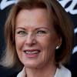
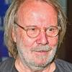
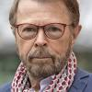
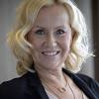
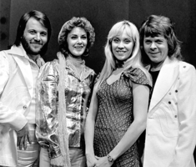
Anni-Frid
Benny
Björn
Agnetha
ABBA in 1974 (from left) Benny Andersson, Anni-Frid Lyngstad (Frida), Agnetha Fältskog, and Björn Ulvaeus

